Slide 1

7th Grade Math
Unit 6, Lesson 10 Solving Multi-Step Proportion Problems Volume 1, pg. 282

Slide 2


Benchmark
MA.7.AR.4.5
Solve real-world problems involving proportional relationships.
volume 1, pg. 282

Slide 3
Integrated Mathematical Thinking and Reasoning Standards
MA.K12.MTR.5.1 Use patterns and structure to help understand and connect mathematical concepts.
MA.K12.MTR.7.1 Apply mathematics to real-world contexts.
volume 1, pg. 282

Slide 4

Learning Target
I can solve multi-step problems involving proportions.
volume 1, pg. 282

Slide 5

Warm-Up
volume 1, pg. 283

Slide 6
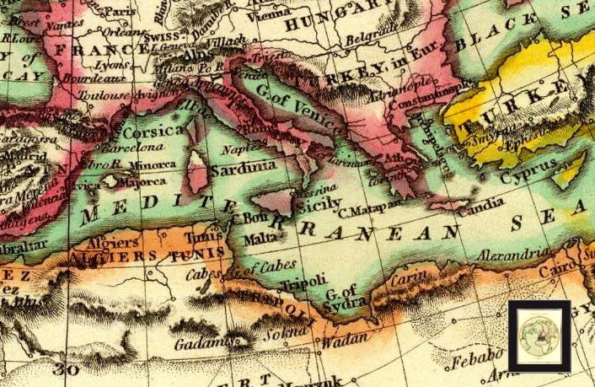
6.10.1 Warm-Up: Making Maps
Cartographers and photogrammetrists are the professionals who collect and analyze data that they then use to create maps. Cartographers design accessible maps for general use, while photogrammetrists create more detailed maps of Earth’s features.
What are some of the ways mathematics can be used for map creation?
volume 1, pg. 283

Slide 7

Collaboration
volume 1, pg. 283

Slide 8

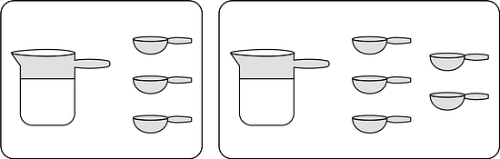
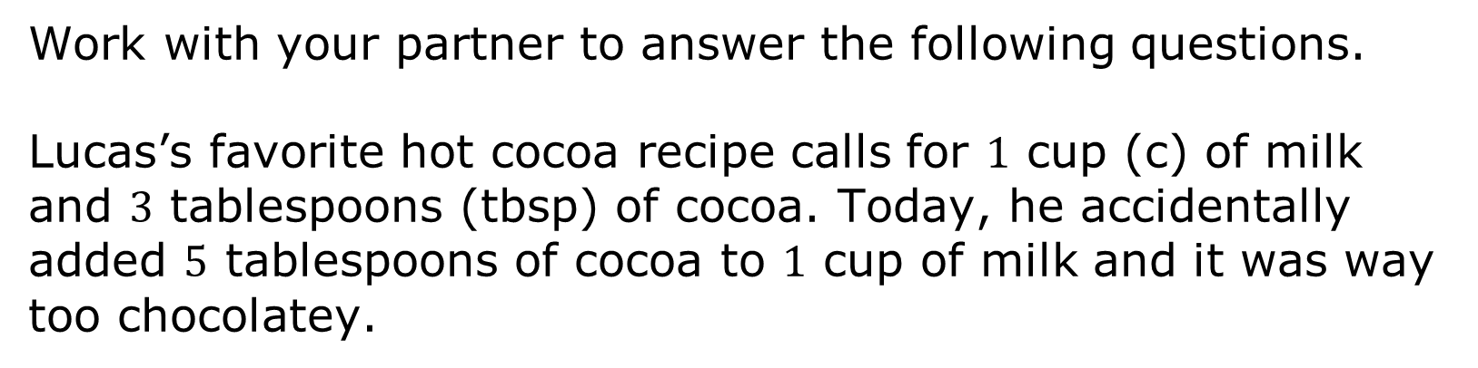
6.10.2 Collaboration: The “Right” Way
Work with your partner to answer the following questions.
Lucas’s favorite hot cocoa recipe calls for $1$ cup (c) of milk and $3$ tablespoons (tbsp) of cocoa. Today, he accidentally added $5$ tablespoons of cocoa to $1$ cup of milk and it was way too chocolatey.
volume 1, pg. 283

Slide 9
His sister Meredith told him he could just add more milk to fix the flavor. How much milk would he need to add to get the right flavor?
His brother Tyler told him he could fix it by adding both milk and cocoa. How much more of each would he need to add to get the right flavor?
Which sibling had the correct solution to Lucas’s problem? Explain.
volume 1, pg. 283

Slide 10

Activity
volume 1, pg. 284

Slide 11

6.10.3 Activity: Gallery Walk
With your group, read the information given in each scenario. Then, write three different questions that could be answered using the information that was given.
Scenario | Questions That Could Be Answered
Two Maps
Favorite Pasta
Making Muffins
volume 1, pg. 284

Slide 12
Choose one scenario. Discuss how each question could be answered. Then complete the table.
Question | My Summary of How to Answer the Question
volume 1, pg. 284

Slide 13

Your Turn
volume 1, pg. 285

Slide 14

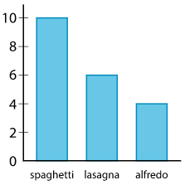
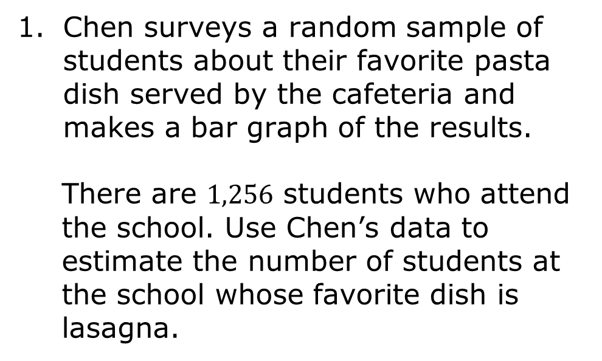
6.10.4 Your Turn!
Chen surveys a random sample of students about their favorite pasta dish served by the cafeteria and makes a bar graph of the results.
There are $1,256$ students who attend the school. Use Chen’s data to estimate the number of students at the school whose favorite dish is lasagna.
spaghetti lasagna alfredo
volume 1, pg. 285

Slide 15

Jaxon is baking blueberry muffins with a recipe that calls for $2$ cups (c) of flour and $\frac{3}{4}$ cup of sugar to make $12$ muffins. Jaxon wants to make as many muffins as possible using $5$ cups of flour.
Exactly how many cups of sugar will Jaxon use if he uses all $5$ cups of flour?
Exactly how many muffins will Jaxon make if he uses all $5$ cups of flour?
volume 1, pg. 285

Slide 16
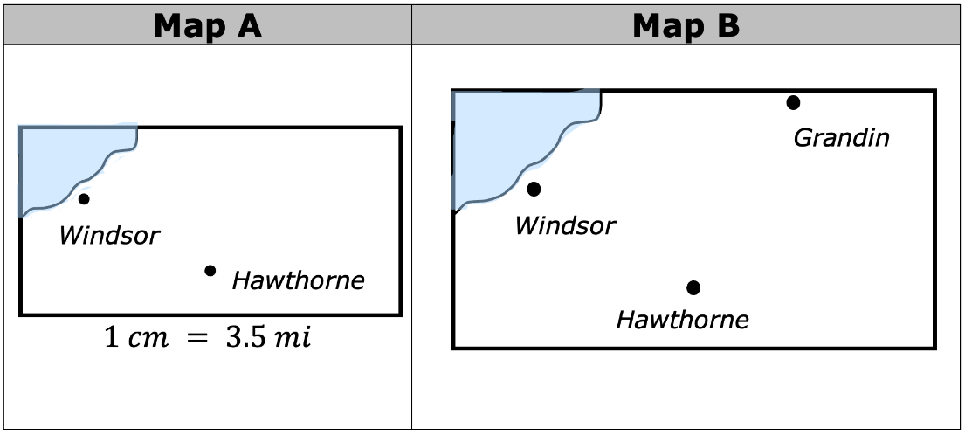
The two maps show the same area at two different scales.
volume 1, pg. 285

Slide 17
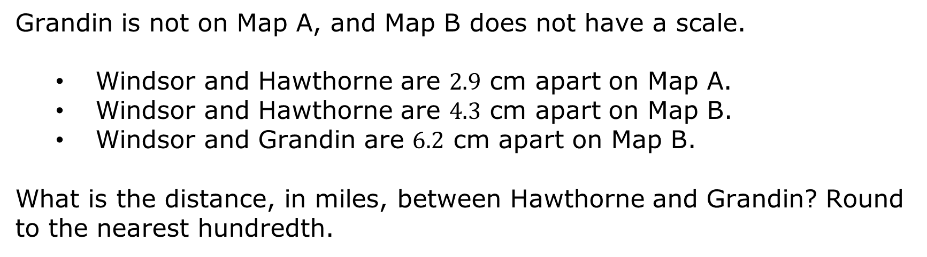
Grandin is not on Map A, and Map B does not have a scale.
Windsor and Hawthorne are $2.9$ cm apart on Map A.
Windsor and Hawthorne are $4.3$ cm apart on Map B.
Windsor and Grandin are $6.2$ cm apart on Map B.
What is the distance, in miles, between Hawthorne and Grandin? Round to the nearest hundredth.
volume 1, pg. 285

Slide 18

Wrap-Up
volume 1, pg. 286

Slide 19
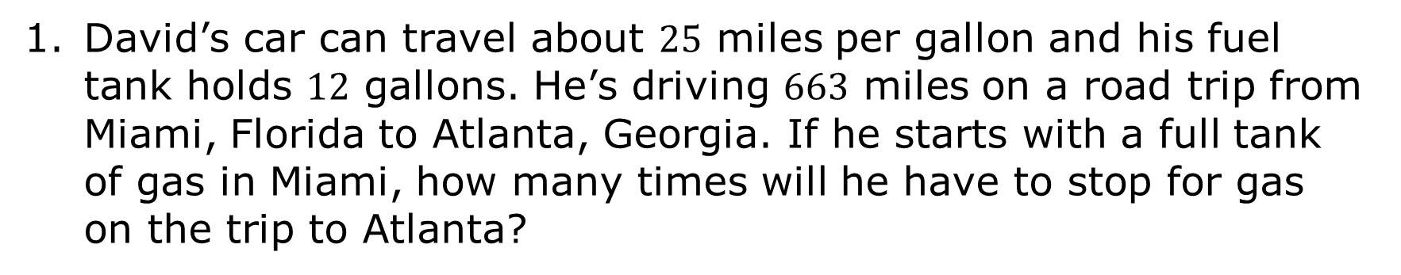
6.10.5 Wrap-Up: Ticket Out the Door
David’s car can travel about $25$ miles per gallon and his fuel tank holds $12$ gallons. He’s driving $663$ miles on a road trip from Miami, Florida to Atlanta, Georgia. If he starts with a full tank of gas in Miami, how many times will he have to stop for gas on the trip to Atlanta?
volume 1, pg. 286

